Slide 1
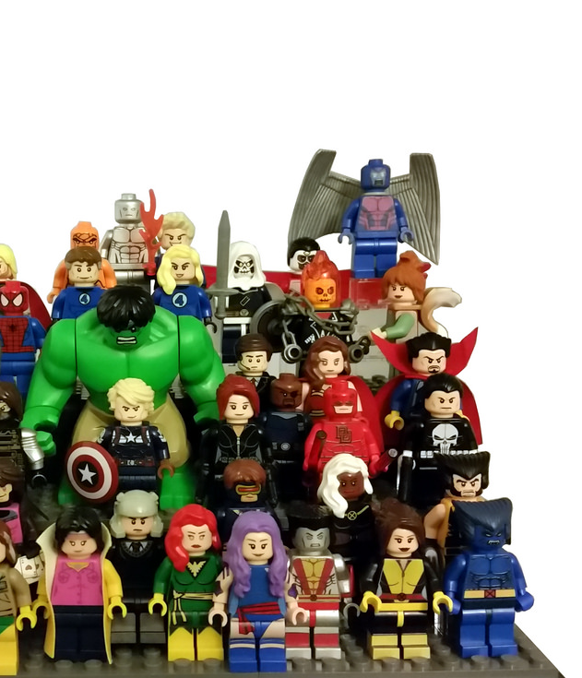
Object-Oriented Programming
CE-1103 Algorithms and Data Structures I

Slide 2
Disclaimer / Descargo de Responsabilidad
Esta presentación corresponde a una guía usada por el profesor durante las clases. La misma ha sido modificada para ser utilizado en el modelo de cursos asistidos por tecnología. No es una versión final, por lo que la misma podría requerir todavía hacer algunos ajustes. Para aspectos de evaluación esta presentación es solo una guía, por lo que el estudiante debe profundizar con el material de lectura asignado y lo discutido en clases para aspectos de evaluación.
This presentation corresponds to a guide material used by the professor during classes. It has been modified to be used in the model of technology-assisted courses. It is not a final version, so it may still require some adjustments. For evaluation aspects, this presentation is only a guide, so the student should delve with the assigned reading material and what has been discussed in class.

Slide 3
What is an Object?

Slide 4

Objects
A general definition
Everywhere you look in the real world, you see things or objects
Plants
Animals
Cars
Buildings
Houses
And the list can go on for hours or days!

Slide 5
Objects
A general definition
We think in terms of objects
Let’s see how natural this is for humans

Slide 6
Think about a car...

Slide 7
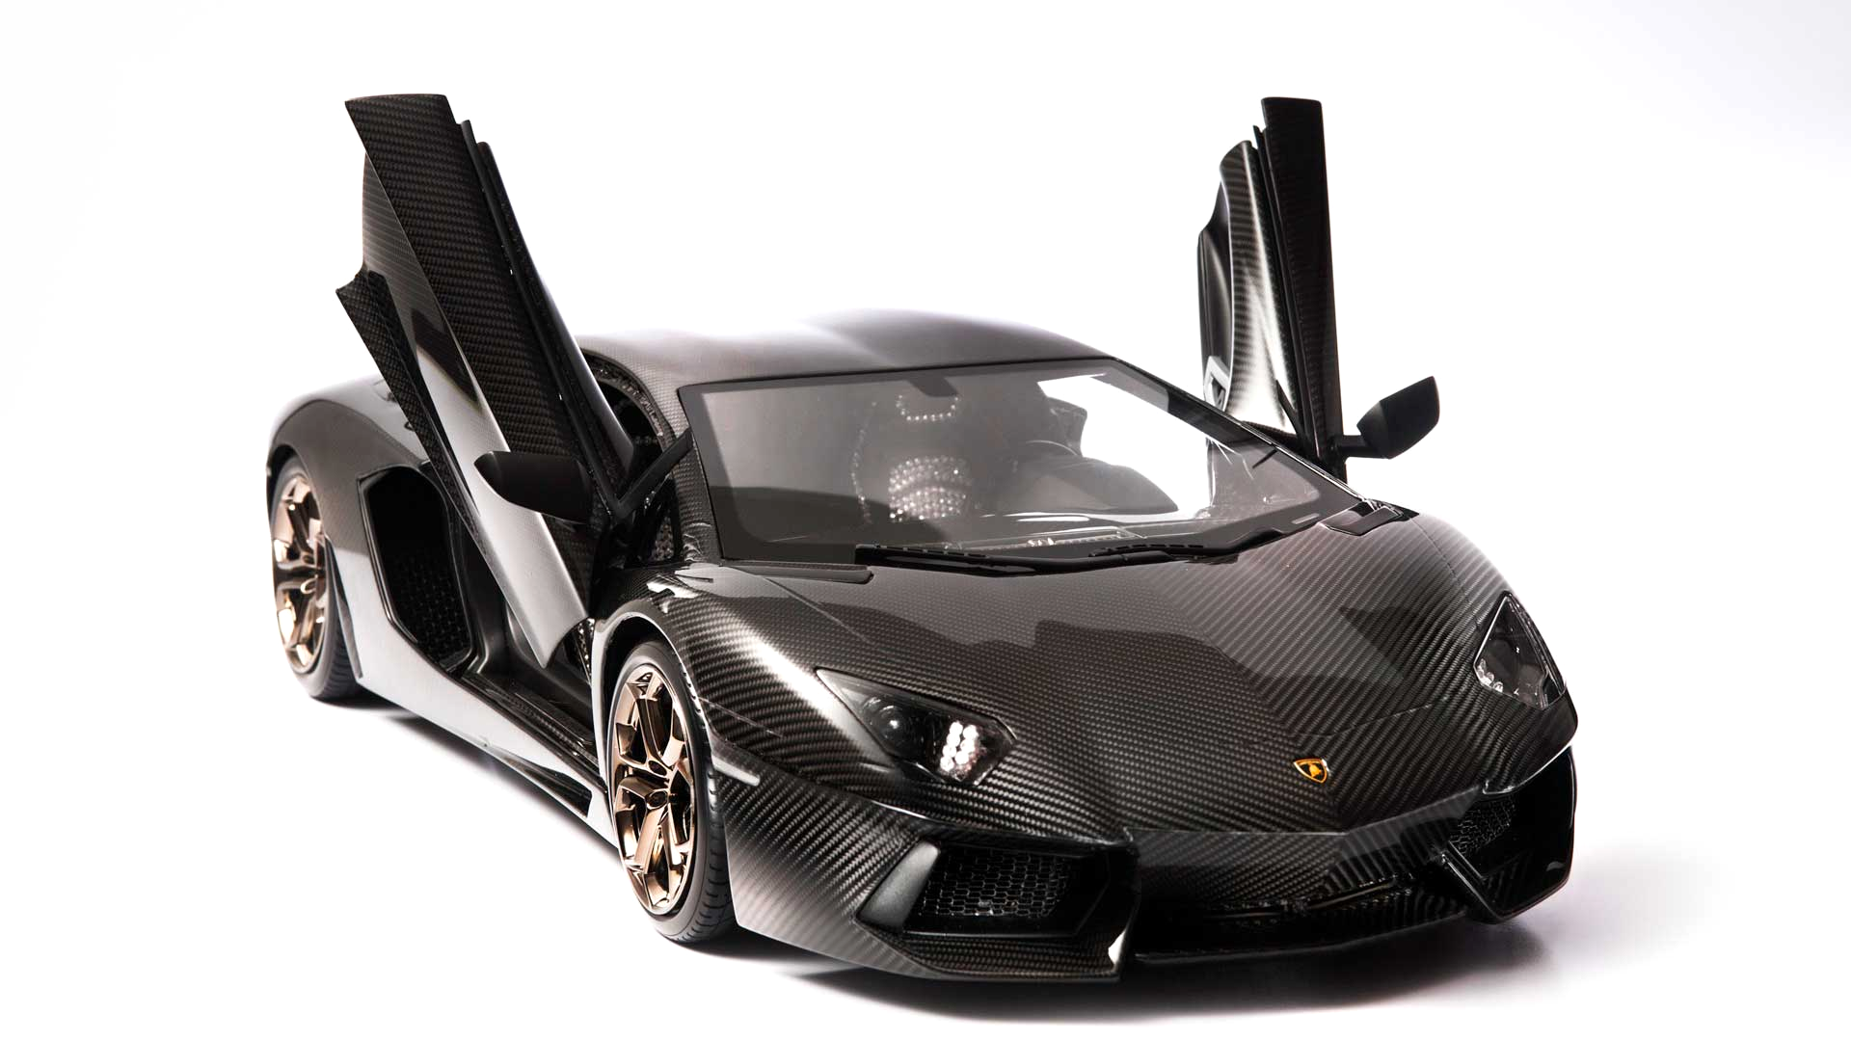

Slide 8
Now describe it!

Slide 9
Objects
A general definition
The car is:
Black
Has doors that open upward
Lamborghini
Made of metal
Heavy
Expensive
Not a Hyundai…
The same I have in my garage!

Slide 10
Objects
A general definition
The car is:
Black
Has doors that open upward
Lamborghini
Made of metal
Heavy
Expensive
Not a Hyundai…
The same I have in my garage!
This description is OK but...

Slide 11
Objects
A general definition
The car is:
Black
Has doors that open upward
Lamborghini
Made of metal
Heavy
Expensive
Not a Hyundai…
The same I have in my garage!
Only mentions the attributes of the object

Slide 12
Objects
A general definition
The car can:
Accelerate
Break
Turn
Play music
Connect to Internet

Slide 13
Objects
A general definition
The car can:
Accelerate
Break
Turn
Play music
Connect to Internet
This includes the behavior of the object

Slide 14
Objects
A general definition
Remember these two keywords: attributes and behavior
Every object in real life has both attributes and behavior and can be described with them
We learn about the objects by observing the attributes and the behavior of each one

Slide 15
Let’s bake a cake

Slide 16
What objects are involved?

Slide 17


Slide 18
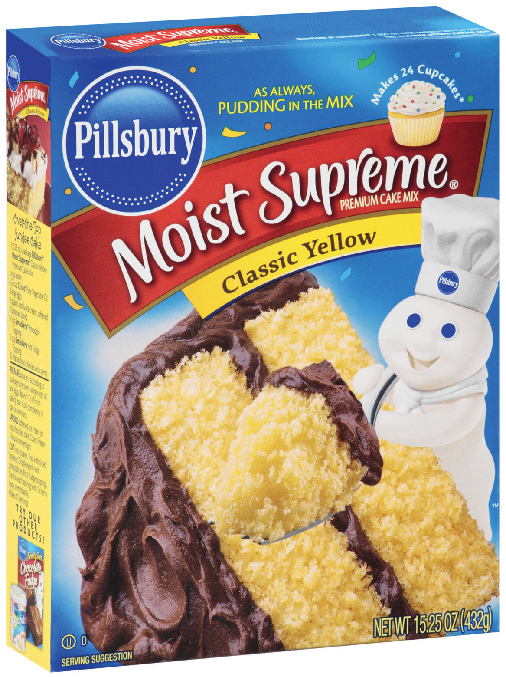

Slide 19
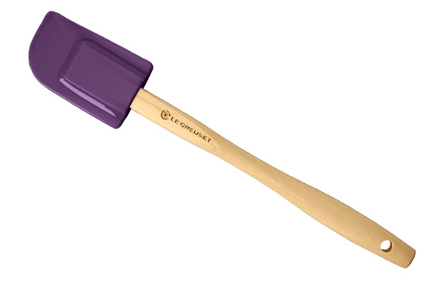

Slide 20


Slide 21


Slide 22
Now define the relationship between the objects

Slide 24
We have to define the attributes of each one

Slide 25

We have to define the attributes of each one
Why!?

Slide 26
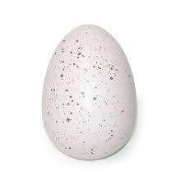
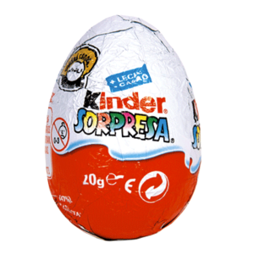
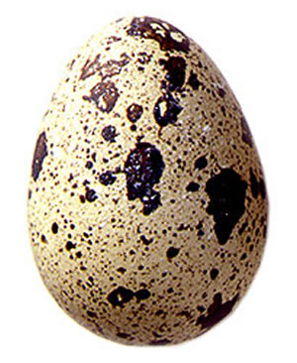
Ok..you need an egg, but what kind of egg?

Slide 27
Now define the behavior...

Slide 28
Now define the behavior...
An egg can’t do anything!
The egg can break...that can be something that the egg “can” do...

Slide 29
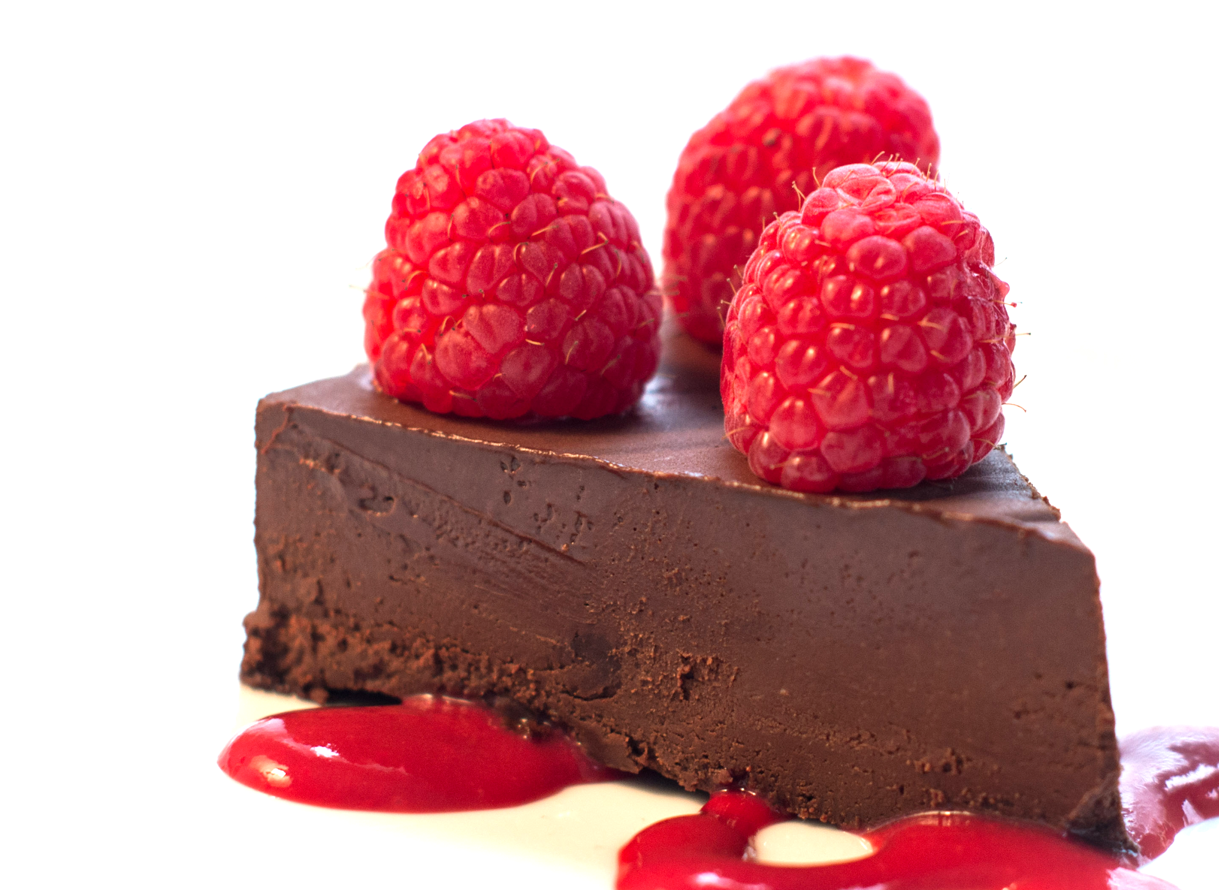
Objects
About the example
This was a very simple example of how we usually solve a problem in real
In real life we don’t pause to think on the attributes and behavior, that is something implicit most of the time
But that doesn’t mean the objects we used don’t have attributes and behavior

Slide 30
Objects
About the example
Keep in mind what we learned
Programming using OO is just as simple. You already know how to do it!

Slide 31
What is a paradigm?

Slide 32
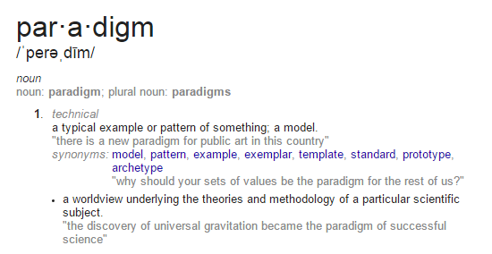

Slide 33
The overall perspective from which one sees and interprets the world

Slide 34
In the context of computer science...

Slide 35
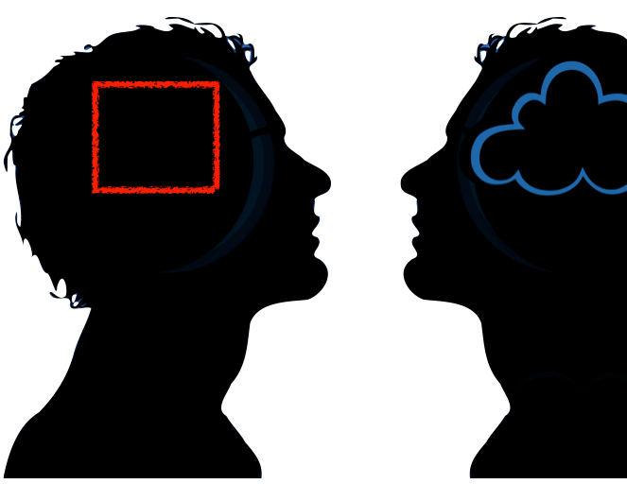
Programming paradigm
Is a fundamental style of computer programming
Serves as a way of building the structure and elements of computer programs
Is how the language “sees” the world

Slide 36

Programming paradigm
In the functional paradigm the real world is modeled as mathematics and functions theory
Functions are first-class citizens
Scheme, Lisp, F#

Slide 37
Programming paradigm
In the functional paradigm the real world is modeled as mathematics and functions theory
Functions are first-class citizens
Scheme, Lisp, F#
What’s a first-class citizen?

Slide 38
Programming paradigm
In the functional paradigm the real world is modeled as mathematics and functions theory
Functions are first-class citizens
Scheme, Lisp, F#
Is an entity that supports all the operations generally available to other entities such as variables
What’s a first-class citizen?

Slide 39

Programming paradigm
In the imperative paradigm the real world is modeled as steps, commands and structures
Structures are first-class citizens
C, C++, PHP

Slide 40

Programming paradigm
In the logic paradigm the real world is modeled as axioms, inference rules and queries.
Rules are first-class citizens
Prolog...
Live long and prosper

Slide 41

Programming paradigm
In the object-oriented paradigm the real world is modeled as objects.
Objects are first-class citizens
Java, C++, C#, SmallTalk
Why has the OO paradigm being so successful?

Slide 42
What is OOP?

Slide 43
Object-Oriented Programming
Design and build programs under the object-oriented paradigm
Models software in terms similar to those that people use to describe real-world objects
Defining the attributes and behavior of a set of objects interacting between each others in order to solve a specific problem

Slide 44
Object-Oriented Programming
There are some important concepts to understand OOP:
Abstraction
Encapsulation
Classes
Attribute
Method
Instance
Inheritance
Polymorphism

Slide 45
What is Abstraction?

Slide 46
The first thing you might think of is art...

Slide 47
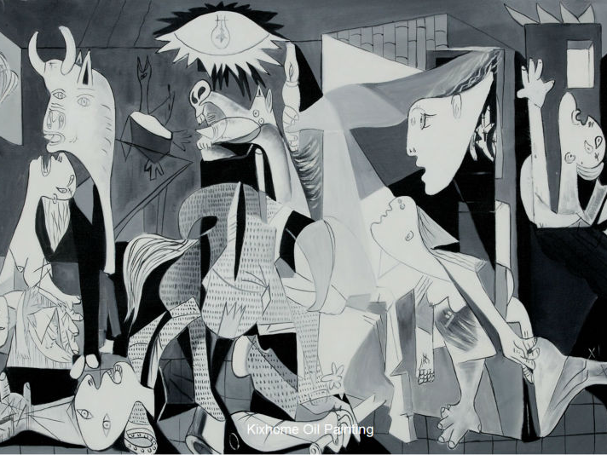

Slide 48
Why is called abstract art?

Slide 49
Object-Oriented Programming Abstraction
Abstraction is a non-accurate representation of the reality
This means that the artist draw that he/she thinks of the reality without being close to the real thing.
For example: draw a house

Slide 50

What is that?

Slide 51
Is that a house? Or a representation of a house?

Slide 52
Where are the electric wires, the pipes, and all the necessary things that a house needs?

Slide 53
Object-Oriented Programming Abstraction
Abstraction is the capacity of the humans to create representations of the reality
These representations omit details to allow us to handle the complexity of the problems
We need to exclude non-relevant details in order to focus on what is really important

Slide 54
Object-Oriented Programming Abstraction
How does this applies to OOP?
In OOP, the abstraction allows us to define objects that represent abstract concepts, perform a specific task, change its state and communicate with other objects
Coding in OOP is like creating an abstract painting

Slide 55

Object-Oriented Programming Encapsulation
An OOP wraps attributes and behavior (operations, methods) into objects
A single entity contains both attributes and behavior
Attributes and objects can be thought as a single block of memory

Slide 56
Object-Oriented Programming Encapsulation
Objects have also the property of information hiding
Objects hide the implementation details from other objects
Interaction between objects is done through a well defined interface

Slide 57
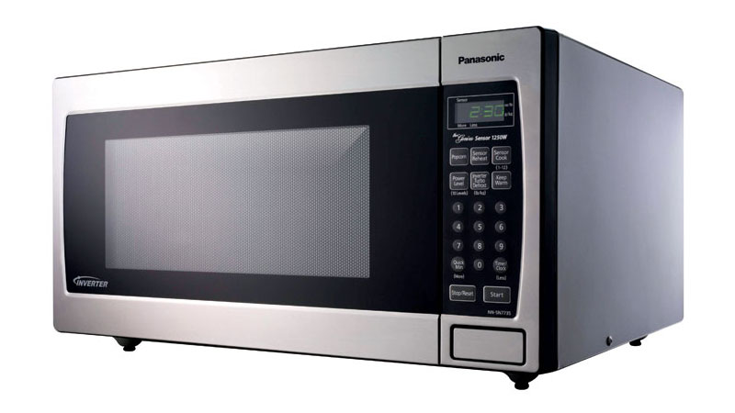
Let’s think about encapsulation when you use a microwave oven

Slide 58
What is a class?

Slide 59


Slide 60
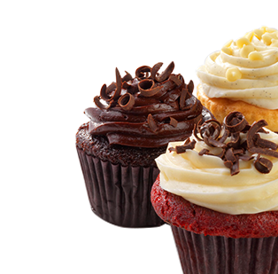
Object-Oriented Programming Classes
A class is like a mold, for example a cupcake mold
The mold defines how the resulting cupcake will look like, but does not define the cupcake itself
With the same mold, you can bake many types of cupcakes

Slide 61
Object-Oriented Programming Classes
You cannot eat the mold
The mold will only help you create new cupcakes that you can eat

Slide 62
Object-Oriented Programming Classes
In OOP classes define the attributes and methods (behavior) that an object will have
A class is a blueprint to instantiate new objects based on it
So, how can we create a new class?

Slide 63
Object-Oriented Programming Classes
You’ll need to define the attributes and methods that the objects based on that class will have
An attribute is a data element of the class. For example, a Car class has attributes such as Top Speed or Max Fuel Capacity.
Both of these are integers and can hold exactly one value at any given moment

Slide 64
Object-Oriented Programming Classes
Think of an attribute as a variable that is linked to the an object. For example, we can have two cars with different top speed
Both are cars, but their attribute TopSpeed is different for each of them.
All humans have different physical attributes, but we all are human beings...

Slide 65
Object-Oriented Programming Classes
Methods are operations that make changes to the attributes of the objects
Methods define the interface of an object, for example, the pedals of a car is part of its interface
Thankfully you never have to interact with the engine to make the car go faster or slow down

Slide 66

Object-Oriented Programming Classes
spike.bark()
spike.roll()
spike.greet()
The car hides the complexity of the engine, and you only interact with its interface
Methods are messages sent to an specific object

Slide 67
Object-Oriented Programming Instance
After you have defined the “mold” now comes the time to bake the cupcakes
Are you going to do chocolate cupcakes or vanilla?
Instantiating is creating an object using the mold or the class defined before

Slide 68
Object-Oriented Programming Instance
After you have defined the “mold” now comes the time to bake the cupcakes
Are you going to do chocolate cupcakes or vanilla?
Instantiating is creating an object using the mold (class) defined before

Slide 69
Object-Oriented Programming Instance
The term instance refers to an object created using a class
Not all instances are the same just like a chocolate cupcake is the same as a vanilla cupcake but both can be considered as cupcakes

Slide 70
Object-Oriented Programming Instance
Each instance is a separate entity
An change on an instance does not affect other instances of the same class
Methods are executed on an specific instance

Slide 71



Dog class
Attributes:
Name, Age, Weight, Aggressiveness
Methods:
Bark, Greet, Roll, Attack
Spot, 2, 12 kg, Low
Devil, 4, 20 kg, Very High
Spike, 1, 2 kg, Middle

Slide 72

Time for a quick review...
Are we clear on:
Abstraction
Encapsulation
Classes
Attribute
Method
Instance

Slide 73
Object-Oriented Programming Inheritance
Animals
Birds
Mammals
Penguin
Parrot
Dog
Whale
Human
In real life objects form hierarchies. For example:

Slide 74
Object-Oriented Programming Inheritance
Animals
Birds
Mammals
Penguin
Parrot
Dog
Whale
Human
Each animal family share attributes and behavior

Slide 75
Object-Oriented Programming Inheritance
In OOP classes can also share attributes and methods using inheritance
This means that a class can be related with other class in a parent-child relationship
Parent class is called base class or superclass.

Slide 76
Object-Oriented Programming Inheritance
The child class is called derived class or subclass
Subclasses inherit attributes and methods of its parent, but it also can add new ones
Let’s go back to the animal hierarchy...

Slide 77
Object-Oriented Programming Inheritance
The child class is called derived class or subclass
Subclasses inherit attributes and methods of its parent, but it also can add new ones
Let’s go back to the animal hierarchy...

Slide 78


Object-Oriented Programming Inheritance
What attributes and behavior share chicken and eagles and with other birds?
What attributes and behavior are different between each other and with other birds?

Slide 79
Object-Oriented Programming Inheritance
Inheritance is a good way of reusing code. At first it may be hard for you, but eventually it will be more natural
Use it when is necessary...the right tool for the right problem
Inheritance = “is a” type of relationship

Slide 80

Object-Oriented Programming Polymorphism
Polymorphism is tightly related to inheritance
It allows to treat different objects as they were the same
A subclass can modify the methods inherited from this parent. This is called overriding

Slide 81
Object-Oriented Programming Polymorphism - Overriding
For example, Bird class has the method putEgg
All subclasses will inherit the same method with the same code. But the way a penguin puts an egg can be different of a parrot's
So Penguin class and Parrot class can change the inherited putEgg method to adjust it to their particular nature

Slide 82
Object-Oriented Programming Polymorphism
So through the use of inheritance and overriding, you can accomplish polymorphism
For example, you may have many Penguins object and many Parrot objects. You can treat them all as Birds and call its method putEgg

Slide 83
Object-Oriented Programming Polymorphism
Which method will be called? The one from Bird Class or the method of each of the subclasses?

Slide 84
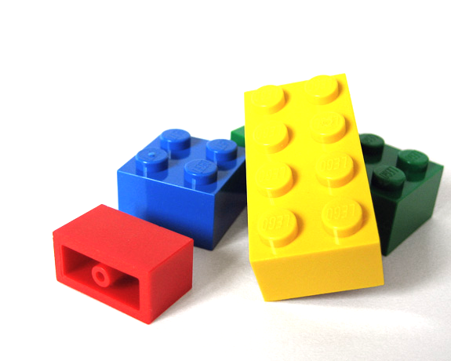
Object-Oriented Programming Modularity
Modularity allows to group logically related abstractions
Each group is a reusable module that can be used from different modules and classes
This avoids using copy-paste of code that you need to reuse

Slide 85
Object-Oriented Programming Modularity
Divide and conquer
It is a good practice to pack logic in different modules
Different languages have different terms to refer to modularity

Slide 86

Time for a another review...
Are we clear on:
Inheritance
Polymorphism
Modularity

Slide 87
Object-Oriented Programming
CE-1103 Algorithms and Data Structures I

Slide 88

Today's fact:
Some Java concepts
Geek Corner "Fun" facts for geeks
Java
When we talk about Java we are referring to two things: a programming language and the JVM
Java is an OO programming language initiated in 1991 by Sun Microsystems
Java is one of the most complete OO languages in the market

Slide 89
Today's fact:
Some Java concepts
Geek Corner
One the main features of Java is its portability. Meaning the same program can run in different platforms
JVM
The term Java also refers to the Java Virtual Machine. What is a virtual machine? Let's discuss about it
The Virtual Machine runs on top of the hardware. That is what allows the portability of a Java program

Slide 90
Today's fact:
Some Java concepts
Geek Corner
Java programs don't talk to the hardware. They talk to the JVM which works as a middle man between them
ByteCode
Java programs are not compiled. When you build a Java program instead of generating native code, it generates what is called ByteCode. This is "native code" for the JVM. The JVM translates in run time the ByteCode to machine code

Slide 91
Today's fact:
Some Java concepts
Geek Corner
Java API
What is an API? The Java API is composed of a lot of packages containing useful functionalities. Each time you write an import statement, you are using the Java API
JRE
The Java Runtine Environment is the JVM plus the class library. This is what you need to install to run Java programs. There is a JRE for each platform

Slide 92
Today's fact:
Some Java concepts
Geek Corner
JDK
Java Development Kit. It is a group of tools that the developers can use to create Java programs. JDK includes the API and tools like compiler, debugger, profiler, among others.
IDE
The Integrated Development Environment. Is the main tool to code programs. Is a tool that integrates the compiler and debugger to help programmers. Some common IDE are Eclipse, Netbeans,

Slide 93
Today's fact:
Some Java concepts
Geek Corner "Fun" facts for geeks
Java
JVM
ByteCode
Java API
JDK
IDE

